Slide 1


Student Reminder App
Name: Tiisetso Matabane
Student no: 202240101
Module: NHCI63110 – Human-Computer Interaction

Slide 2
Topics:
User Research, Personas, Scenarios
Conceptual Model & Interaction Thinking
Interface Sketches
Django Wireframe (structure & layout)
Evaluation Plan
Reflection

Slide 3

User Research
students struggle with balancing academics and well-being, leading to stress, burnout, and missed deadlines.
Main Points:
- Missed deadlines
- Burnout from poor work-life balance
- Disconnected scheduling tools

Slide 4
Personas
🧑 Thabo – Final-year CS student
- Overwhelmed by project deadlines, forgets to take breaks
👩 Lerato – First-year ICT student
- Needs time management support, experiences anxiety

Slide 5
Scenarios
Scenario 1: Thabo receives a break reminder after 2 hours of focused study.
Scenario 2: Lerato views a color-coded calendar to plan her day with wellness breaks.

Slide 6
Core Functionalities
Task & Reminder Management
Add/edit/delete academic tasks
Automatic reminders before due dates
Calendar Integration
Visual weekly/monthly calendar of tasks and wellness entries
Push Notifications
Reminders for upcoming tasks
User account system
Personalised dashboard after login
Secure task data storage

Slide 7
Interaction & metaphor
Interaction Types:
Instructing (forms, buttons)
Conversing (chatbot wellness check-ins)
Exploring (calendar, progress tracking)
Interface Metaphor:
Digital Wellness Planner
Like a personal planner or bullet journal combined with a wellness coach. It visually resembles a physical agenda but integrates intelligent, digital support to promote academic balance and self-care.

Slide 8

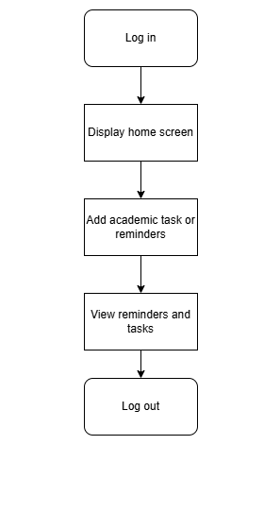
Conceptual Model

Slide 9
Narrative explanation
This conceptual model presents the Student Reminder App as the central system, supporting two major domains: academic management and wellness tracking.
User Roles
Students log in and interact with the system to manage both school-related tasks and emotional wellbeing.
The system tailors content based on time, task urgency, and previous wellness input.
Interaction Flow
Task Reminders: Users add tasks through simple forms.
Wellness Check-ins: Triggered either automatically or manually, students answer questions about their mood and receive instant feedback or tips.

Slide 10
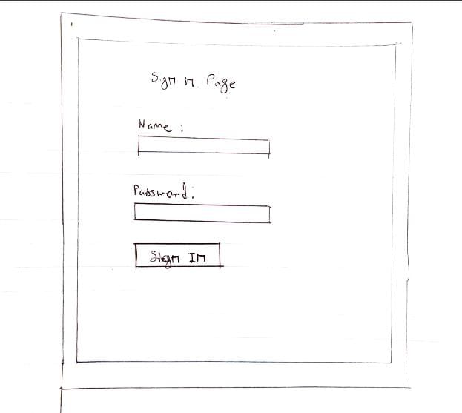
Interface Sketches

Slide 11
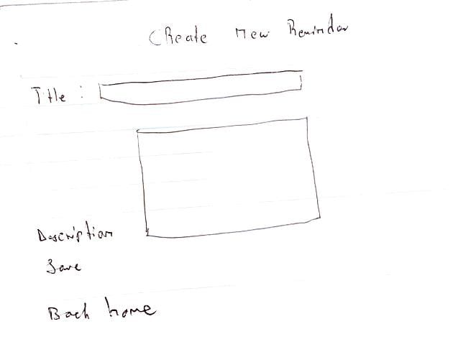
Interface sketches

Slide 12
Design principles
Annotations:
Visibility (Clear Priorities)
Calendar , Tasks , and icons are prominently placed at the top for quick access.
Task list is prioritized over other elements (larger font, centered).
Feedback (Interactive Elements)
Mood selector shows immediate visual feedback (e.g. highlights when selected)..
Constraints (Guided Actions)
"Submit" button for mood check-in is disabled until a mood is selected (grayed out).
GITHUb link
https://github.com/Tiisetso-githb/Reminder_tiisetso.git

Slide 13
Django wireframe (github link)
https://github.com/Tiisetso-githb/Reminder_tiisetso.git

Slide 14
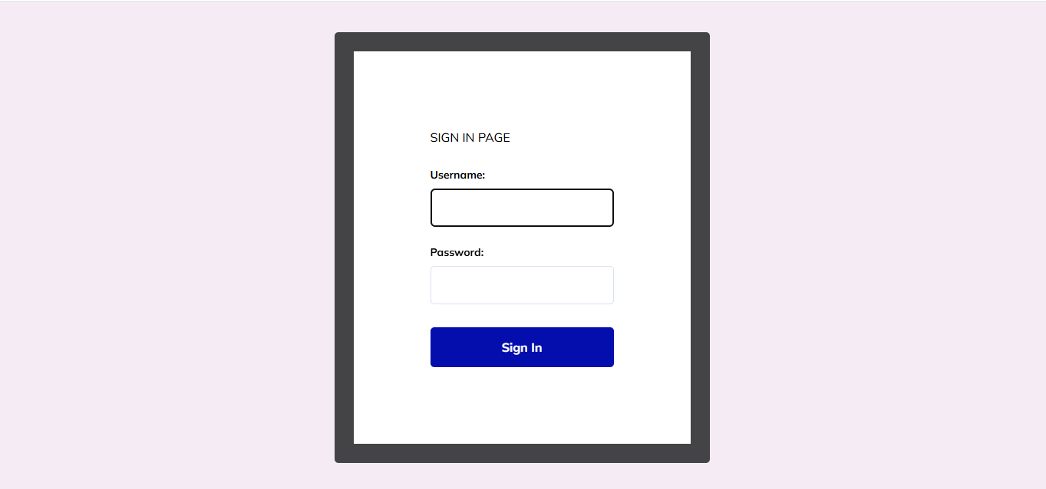
Screenshot

Slide 15
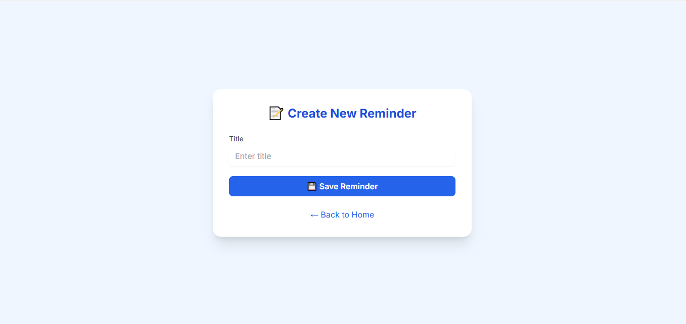
Screenshot

Slide 16
Evaluation Planning
Usability Goals:
-Efficiency : Complete task in ≤30 seconds
- Improve user control by 20% in 1 week
Method: Think-Aloud with 5 students
Testing Questions:
- Was the interface intuitive?
- Were reminders helpful or annoying?
- what additional information would you want o the dashboard?

Slide 17

Reflection
Learnings:
- Importance of listening to users
- Concept modeling clarified app structure
- Wireframes helped reveal practical limitations
Test before builiding

Slide 18

Thank you

